Slide 1
NP-Completeness

Slide 2
Hard problems / Easy problems
Finding the longest simple path between vertices v and w in a given graph
Determine if there is a Hamiltonian circuit in a given graph
Finding the shortest simple path between vertices v and w in a given graph
Determine if there is an Euler tour in a given graph

Slide 3
P, NP, NP-Complete
P: solvable polynomial time. on inputs of size n, their worst-case running time is O(n^{k}), where k is a constant
NP:
nondeterministic polynomial time
Verifiable in polynomial time
NP-Complete: No polynomial-time algorithm has yet been discovered for an NP-computer problem, nor has anyone yet been able to prove that no polynomial-time algorithm can exist for any one of them.

Slide 4
Reductions
Suppose that there is a different decision problem, say B, that we already know how to solve in polynomial time. Finally, suppose that we have a procedure that transforms any instance α of A into some instance β of B with the following characteristics:
1.The transformation takes polynomial time.
2.The answer are the same. That is, the answer for α is “yes” if and only if the answer for β is also “yes.”

Slide 5
yes
yes
α
Polynomial-time
reduction algorithm
β
Polynomial-time
Algorithm to decide B
no
no
Polynomial-time algorithm to decide A
We can call such a procedure a polynomial-time reduction algorithm and, it provides us a way to solve problem A in polynomial time:
1.Given an instance α of problem A, use a polynomial-time reduction algorithm to transform it to an instance β of problem B.
2.Run the polynomial-time decision algorithm for B on the instance β.
3.Use the answer for β as the answer for α.

Slide 6
Abstract Problems: An abstract problem Q is a binary relation on a set of problem instances and a set S of problem solutions.
Decision problems: those having yes/no solution.
Optimization problems: recast by imposing a bound on the value to be optimized.

Slide 7
Tractable and Intractable Problems
Problems in P are also called tractable
Problems not in P are intractable or unsolvable
Can be solved in reasonable time only for small inputs
Or, can not be solved at all
Are non-polynomial algorithms always worst than polynomial algorithms?
- n^{1,000,000} is technically tractable, but really impossible - n^{log log log n} is technically intractable, but easy

Slide 8
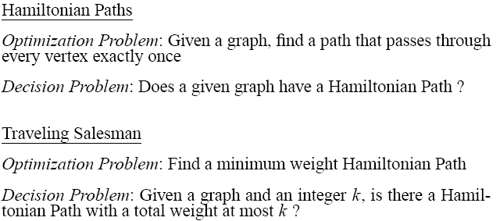

Slide 9
Clique
Clique Problem:
Undirected graph G = (V, E)
Clique: a subset of vertices in V all connected to each other by edges in E (i.e., forming a complete graph)
Size of a clique: number of vertices it contains
Optimization problem:
Find a clique of maximum size
Decision problem:
Does G have a clique of size k?
Clique(G, 2) = YES
Clique(G, 3) = NO
Clique(G, 3) = YES
Clique(G, 4) = NO

Slide 10
Hamiltonian Cycle
Given: a directed graph G = (V, E), determine a simple cycle that contains each vertex in V
Each vertex can only be visited once
Certificate:
Sequence: ⟨v₁, v₂, v₃, …, v_{|V|}⟩
Not a Hamiltonian Hamiltonian

Slide 11
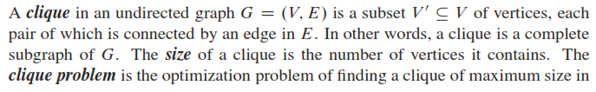

Clique Problem

Slide 12

Vertex Cover

Slide 13
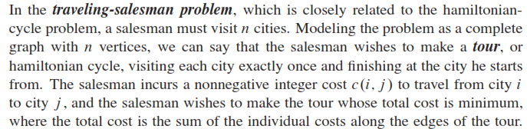
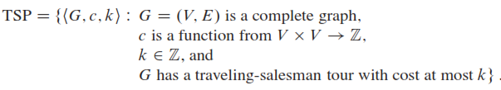
Travelling Salesperson Problem

Slide 14
Subset Sum Problem
Given a finite set S of positive integers and an integer target t >0, find whether there exists a subset S’ contained in S whose elements are sum to t.

